Slide 1
3D Graphics LH 2

Slide 2
Projection
Transformation that changes a point in n-dimensional coordinate system into a point in a coordinate system that has dimension less than n.
• Converts 3-D viewing co-ordinates to 2-D projection co-ordinates
• View Plane or Projection Plane:
Two dimensional plane in which 3D objects are projected is called the view plane or projection plane.
Simply it is a display plane on an output device

Slide 3
Types of Projection
1.Parallel Projection
a)Orthographic parallel projection
b)Oblique parallel projection
2.Perspective Projection

Slide 4
1 . Parallel Projection
• Coordinate positions are transformed to view plane along parallel lines (projection lines)
• Preserves relative proportions of objects
• Accurate views of various sides of an object are obtained.
• Doesn’t give realistic representation of the appearance of the 3-D object
Types
• Orthographic- when the projection is perpendicular to the view plane. Used to produce Front, Side and Top view of an object
• Oblique – when the projection is not perpendicular to the view plane

Slide 5
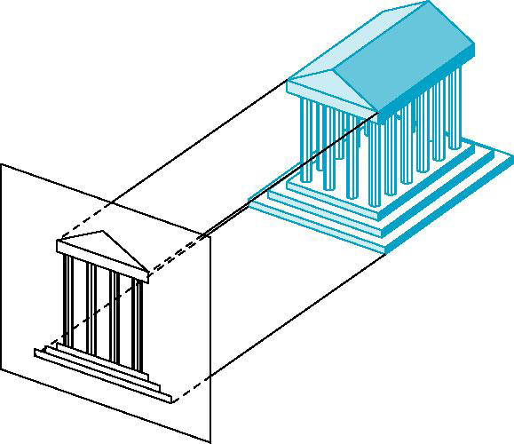
Parallel projection

Slide 6
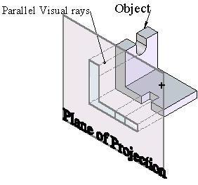
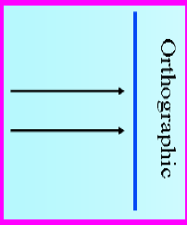
1.1. Orthographic Parallel Projection
•When projection is perpendicular to view plane then it is called orthographic parallel projection

Slide 7
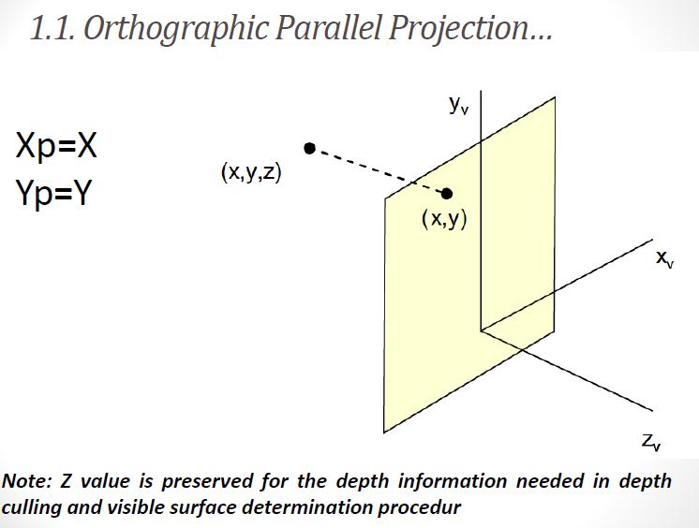

Slide 8
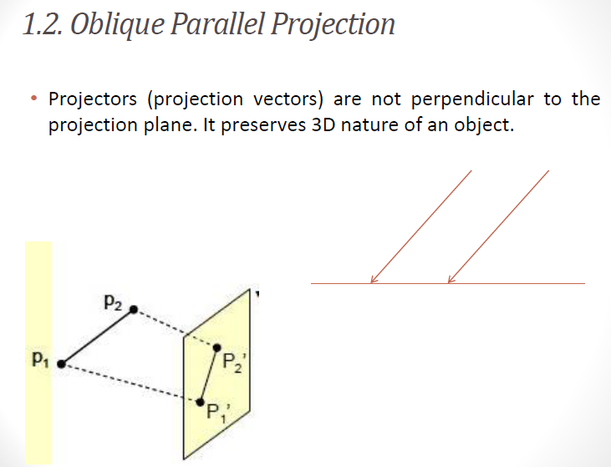

Slide 9
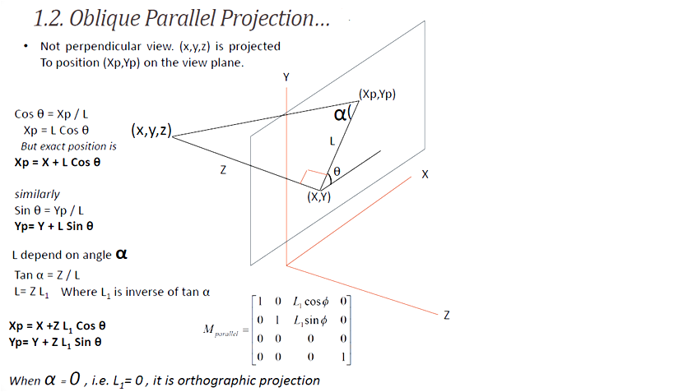

Slide 10
2. Perspective Projection
Coordinate positions are transformed to view plane along lines (projection lines) that converges to a point called projection reference point (center of projection)
• Produce realistic view
• Does not preserve relative proportions
• Equal sized object appears in different size according as distance from view plane

Slide 11
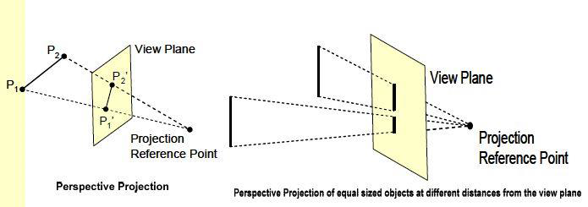

Slide 12
Perspective Projection:
In this projection, the co-ordinate positions are transformed to the view plane along lines that converges to a point called as center of projection

Slide 13
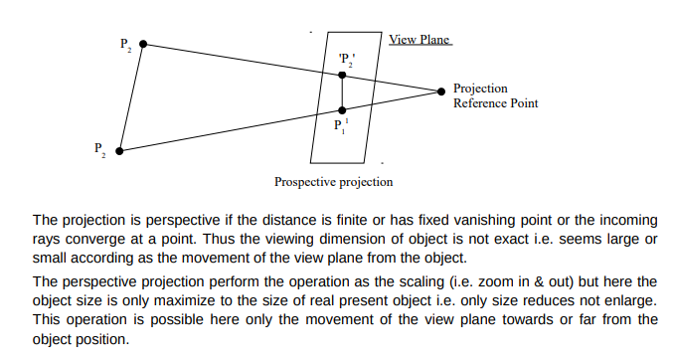

Slide 14
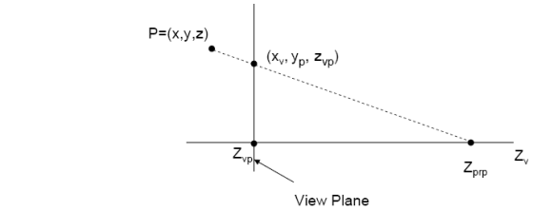
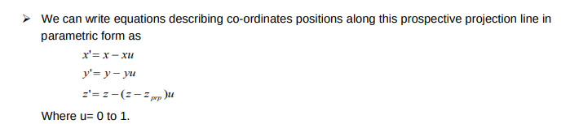

Slide 15
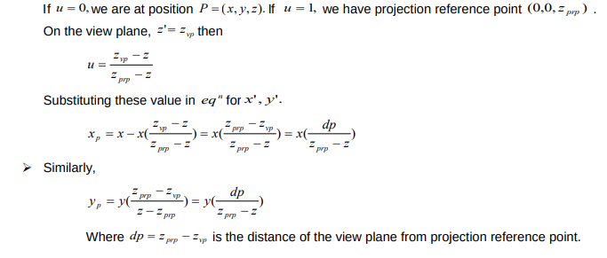

Slide 16
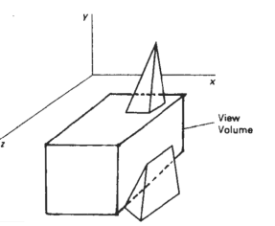
Clipping in 3 D
Clipping in three dimensions can be accomplished using extensions of two-dimensional clipping methods.
Instead of clipping against straight-line window boundaries, we now clip objects against the boundary planes of the view volume. (The view volume defines the three-dimensional volume in space that, once projected, is to fit within the view port.
There are two parts to the view volume: the view plane rectangle and the near and far clipping planes)

Slide 17
An algorithm for three-dimensional clipping identifies and saves all surface segments within the view volume for display on the output device.
All parts of objects that are outside the view volume are discarded.
View-volume clipping boundaries are planes whose orientations depend on the type of projection, the projection window, and the position of the projection reference point

Slide 18
To clip a polygon surface, we can clip the individual polygon edges. To clip a line segment against the view volume, we would need to test the relative position of the line using the view volume's boundary plane equations.
An endpoint (x, y, z) of a line segment is
➢ Outside a boundary plane: Ax + By + Cz + D > 0, where A, B, C, and D are the plane parameters for that boundary.
➢ Inside the boundary if Ax + By + Cz + D < 0

Slide 19
Cubic Spline and Bezier Curve
Splines are the smooth curves passing through a set of given points.
By varying the number and position of the lead weights, the shape of the spline is changed so that it passes through some designated set of points.
In computer graphics, continuous curve that are formed with polynomial section with certain boundary conditions are called spline curve.
Splines are of two types
a. Closed Splines: the generated curve will touch the first and last legs of the control
b. Open Splines : the generated curve will not touch the first and last legs of the control

Slide 20
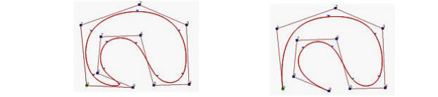
A cubic spline is a spline constructed of piecewise third-order polynomials which pass through a set m of control points.
Splines are used:

Slide 21
➢ To design curve and surface shapes in graphics applications,
➢ To digitize drawings for computer storage
➢ To specify animation paths for the objects or image.
➢ Typical CAD applications for splines include the design of automobile bodies, aircraft and spacecraft surfaces, and ship hulls

Slide 22
Bezier Curve
A Bezier curve is a mathematically defined curve used in two-dimensional graphic applications. The curve is defined by four points: the initial position and the terminating position (which are called "anchors") and two separate middle points (which are called "handles").
The shape of a Bezier curve can be altered by moving the handles.
The mathematical method for drawing curves was created by Pierre Bézier in the late 1960's for the manufacturing of automobiles.

Slide 23
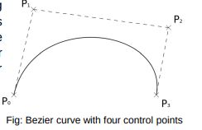

Slide 24
In general, a Bezier curve can be fitted to any number of control points.
The number of control points to be approximated and their relative position determine the degree of the Bezier polynomial.
As with the interpolation splines, a Bezier curve can be specified with boundary conditions, with a characterizing matrix, or with blending functions.
The Bezier curve has two important properties:
It always passes through the first and last control points.
It lies within the convex hull (convex polynomial boundary) of the control points.

Slide 25
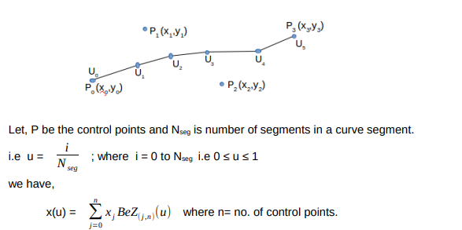

Slide 26
